Slide 1

ENHANCING PLAYER SUPPORT
For Gravity Guy and Fireboy and Watergirl Games
Presented By: Varshini A
Notes:
Hello, I'm Varshini A, and today I will be discussing how we can enhance player support for the games Gravity Guy and Fireboy and Watergirl.
Our goal is to attract a broader player base and enhance the competitive edge of Mobalytics by understanding player psychology and addressing common player requests.

Slide 2
2
AGENDA
  Executive summary
  Player Psychology Overview II
  Genre and Games Overview
  Recommendations
  Player Psychology Overview 1
  Concluding Thoughts
  Q&A
Mobalytics | Extern
Notes:
Here’s the agenda for today’s presentation. We’ll start with an executive summary, then move on to an overview of the genre and games, followed by a detailed look at player psychology. After that, I'll present our recommendations and conclude with final thoughts.

Slide 3
3
INTRODUCTION
  Situation and Complication: Mobalytics aims to diversify its offerings to attract a broader player base and enhance competitive edge. There is a need to understand player psychology and common requests for effective support.
  Chosen Genre: Endless Runner (Gravity Guy) and Cooperative Puzzle-Platformer (Fireboy and Watergirl).
  Gravity Guy: A fast-paced endless runner game that challenges players' reflexes and timing through gravity manipulation.
Mobalytics | Extern
Notes:
Mobalytics aims to diversify its offerings to attract a broader player base. Understanding player psychology and common requests is crucial for providing effective support.
We have chosen two genres: Endless Runner with Gravity Guy and Cooperative Puzzle-Platformer with Fireboy and Watergirl.
Gravity Guy is a fast-paced endless runner game that challenges players' reflexes and timing through gravity manipulation.

Slide 4
4
INTRODUCTION
  Fireboy and Watergirl: A cooperative puzzle-platformer that emphasizes teamwork and strategic thinking.
  Support Recommendations:
  Player Psychology Focus: Tap into motivations such as competition, exploration, and social interaction.
  Common Player Requests: More comprehensive guides, community features, and personalized gameplay tips.
  System Gaps: Enhance analytics for cooperative games, improve community engagement features, and provide targeted performance insights.
Mobalytics | Extern
Notes:
This game is a cooperative puzzle-platformer that emphasizes teamwork and strategic thinking.
We need to focus on player psychology, such as motivations like competition, exploration, and social interaction. Common player requests include more comprehensive guides, community features, and personalized gameplay tips.
We should enhance analytics for cooperative games, improve community engagement features, and provide targeted performance insights.

Slide 5
5
FIREBOY AND WATERGIRL
Chosen for its unique cooperative gameplay that emphasizes teamwork and problem-solving.
Profile
Motivation
Player Name: Varshini
Avatar: Fire and Water duo
Preferred Genre: Puzzle-Platformer
Experience Level: Intermediate
Collaboration: Enjoys working together to solve puzzles.
Challenge: Loves tackling difficult levels.
Exploration: Interested in discovering new game mechanics and strategies.
Mobalytics | Extern
Notes:
Let's profile a typical player. Varshini, an intermediate player, enjoys puzzle-platformers, collaboration, tackling difficult levels, and exploring new game mechanics.
Key motivations include collaboration, challenge, and exploration.

Slide 6
6
FIREBOY AND WATERGIRL
Chosen for its unique cooperative gameplay that emphasizes teamwork and problem-solving.
Community
Resources
  Participates in online forums and co-op gaming groups.
  Follows popular YouTube channels for tips and tricks.
  Dual-controller setup for optimal gameplay.
  Community forums for level strategies.
Mobalytics | Extern
Notes:
Players participate in online forums and co-op gaming groups, and follow YouTube channels for tips and tricks.
They use a dual-controller setup for optimal gameplay and community forums for level strategies.

Slide 7
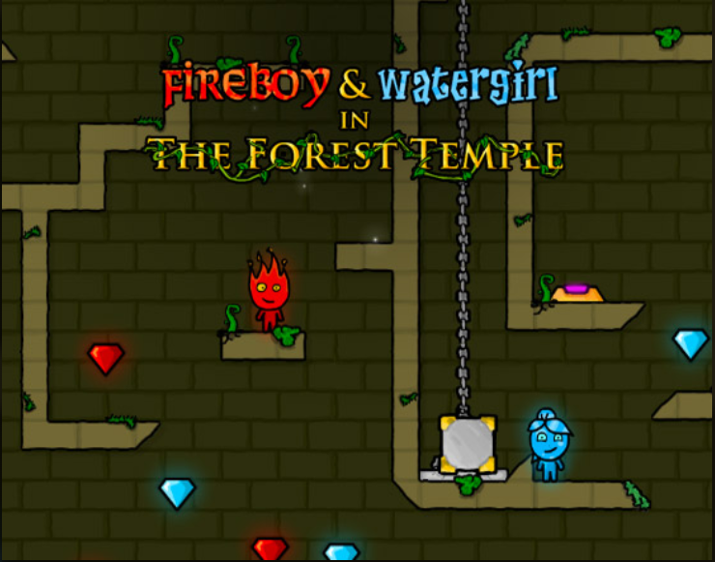
7
FIREBOY AND WATERGIRL
Chosen for its unique cooperative gameplay that emphasizes teamwork and problem-solving.
  Fireboy and Watergirl 1: The Forest Temple.
  Fireboy and Watergirl 2: The Light Temple.
  Fireboy and Watergirl 3: The Ice Temple.
  Fireboy and Watergirl 4: The Crystal Temple.
  Fireboy and Watergirl 5: Elements.
  Fireboy and Watergirl 6: Fairy Tales.
Mobalytics | Extern
Notes:
The series includes several titles like The Forest Temple, The Light Temple, The Ice Temple, The Crystal Temple, Elements, and Fairy Tales.

Slide 8
8
GRAVITY GUY
Chosen for its fast-paced, reflex-intensive gameplay and unique gravity mechanics.
Profile
Motivation
Player Name: Varshini
Avatar: Gravity-defying hero
Preferred Genre: Endless Runner
Experience Level: Advanced
Competition: Thrives on beating high scores.
Achievement: Enjoys setting new records.
Reflex Challenge: Loves fast-paced action requiring quick reflexes.
Mobalytics | Extern

Slide 9
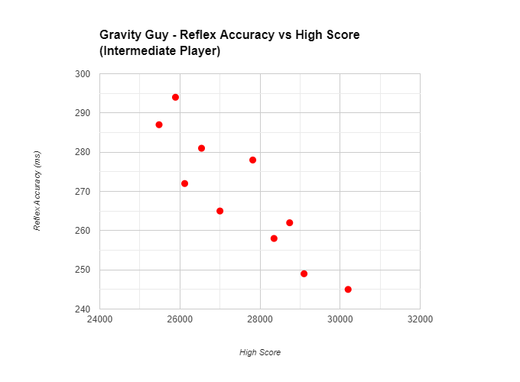
9
GRAVITY GUY
Chosen for its unique cooperative gameplay that emphasizes teamwork and problem-solving.
Gameplay and Performance
  Play-styles: Aggressive, Fast-paced
  Performance Metrics: High score, survival time, reflex accuracy
Mobalytics | Extern

Slide 10


10
GRAVITY GUY
Chosen for its unique cooperative gameplay that emphasizes teamwork and problem-solving.
Community
  Participates in online leaderboards and challenges.
  Follows competitive streaming platforms.
Mobalytics | Extern

Slide 11
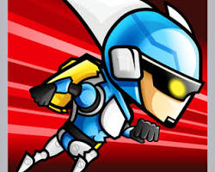
11
GRAVITY GUY
Chosen for its unique cooperative gameplay that emphasizes teamwork and problem-solving.
Resources
  High-refresh-rate monitor for smooth gameplay.
  Engages with competitive gaming forums for tips.
Mobalytics | Extern

Slide 12
RECOMMENDATIONS
12
Gaps in the Current System
  Limited analytics for cooperative gameplay.
  Lack of community engagement features.
  Insufficient personalized performance insights.
Mobalytics should consider expanding their services to these games because of the diverse player motivations and the potential for personalized insights.
Mobalytics | Extern
Oppurtunities
  Develop advanced analytics tools for cooperative games.
  Create robust community features to foster engagement.
  Offer tailored performance feedback based on individual and team metrics.

Slide 13
13
CONLUDING STATEMENT
1
Context: Research highlights the need for diversified player support to attract a broader player base.
2
Insight: Focusing on player psychology and common requests can significantly enhance player satisfaction.
Mobalytics | Extern
3
Next Steps: Further research into player needs, development of new tools, and implementation of community features.
4
Most Important Takeaway: Mobalytics has a significant opportunity to expand its services and improve player experiences by addressing current system gaps and focusing on player motivations.

Slide 14
Mobalytics | Extern
THANK YOU
Presented By : Adeline Palmerston

